Slide 1
Composition
By Ryan Smith

Slide 2
What is composition?
Composition in music is the process of writing a song from start to finish and in this case from scratch.
This is used in all different types of genres ranging from pop to classical music
Composition can range from just instrumental music to just digital instruments or it could be a band set up with vocals and lyrics.

Slide 3
Why have I chosen this project?
I have chosen composition as my project as it’s something that interests me in the music industry. Composition interests me because I like the free will of writing your own piece with your own lyrics and own instrumental section.
It also interests me to find out how my idols came up with there ideas and how the song came about and how there influences inspired them to play and compose that style of music to help benefit me in my musical journey and my song writing.
I also chose this as I want to test how good my creativity and ability is to write a song from scratch to perform at our gig at the philharmonic hall in liverpool

Slide 4
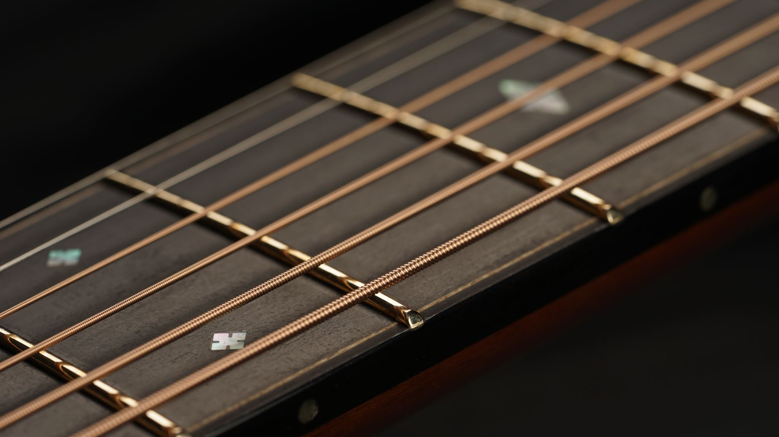
Basic Chord Progressions

Slide 5
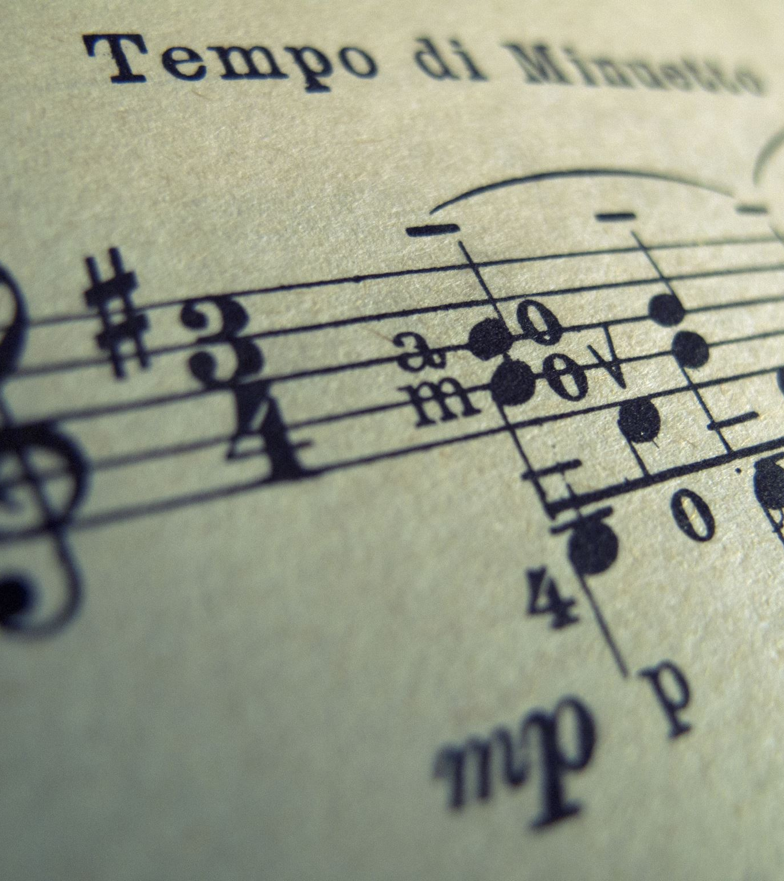
what is a basic chord progression?
Chord progressions are pretty important in the music industry as thye are the starting point of any composition in the world and they are the key to every song. This where another thing called key signatures comes in which determines what chords sound good together and what chords don’t sound good together so your song doesn’t sound strange
chord progressions can range from being quite simple to quite complex and the progression can get more complex no matter what genre.
Chord progression are formatted in roman numerals and this is done is to contextualize the chord you are using to that key. A perfect example of this is using a basic chord progression which would be I-V-vi-IV which is known as “the pop progression” in many musicians eyes.
An example of this progression being used is girls like you by Maroon 5

Slide 6
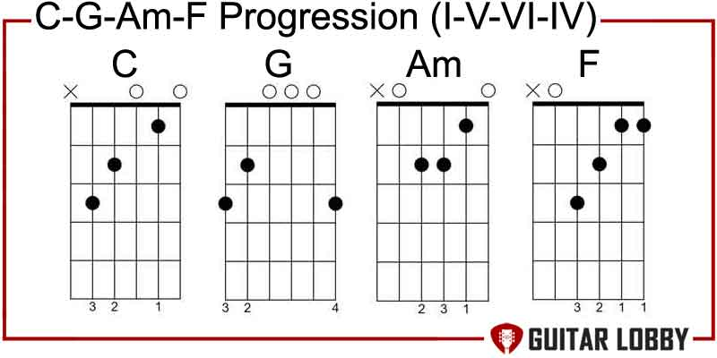
Examples of a basic chord progression in the key of c

Slide 7
how I will utilize this?
I will utilize this by knowing how chords work in the key on what chords work better together.
This will help make my process of composing this song a lot easier down the line as it will make the song come across better within the genre I want to do.
Here is an audio recording of me messing about with the I-V-vi-IV when thinking of a progression to use for my song

Slide 8
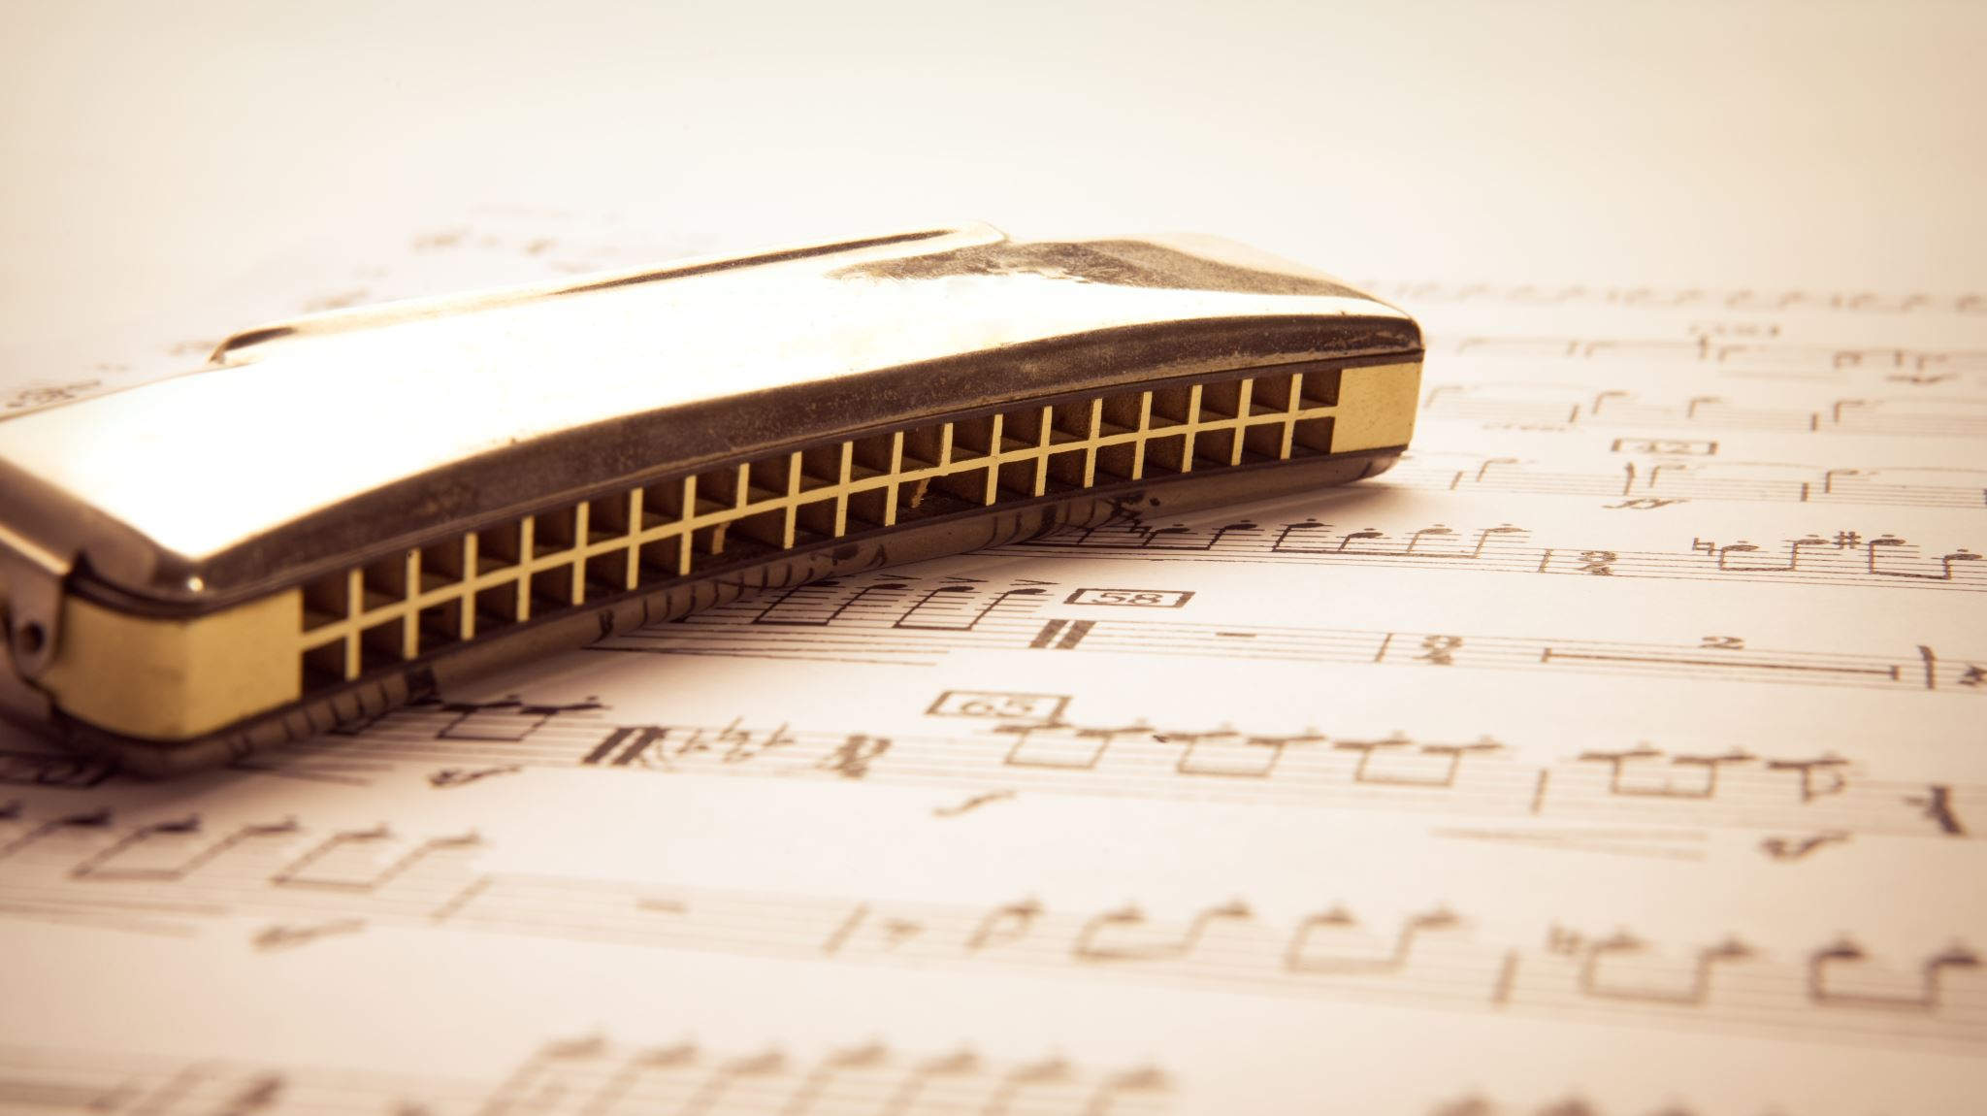
Melodies

Slide 9
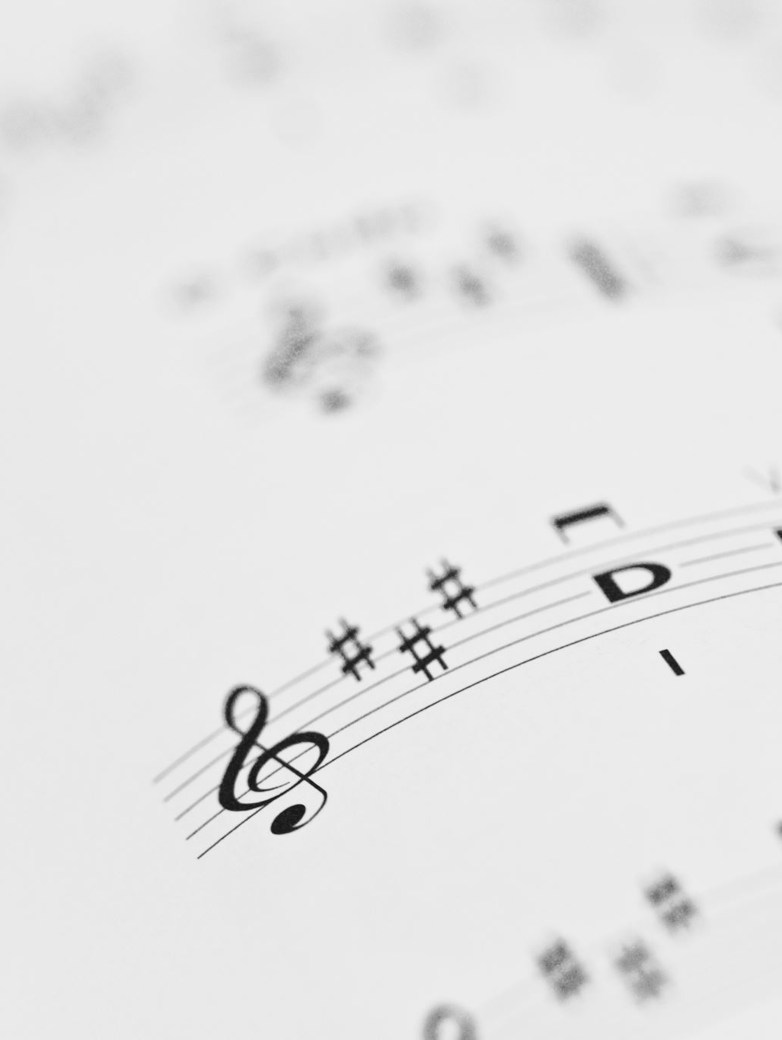
What is a melody?
A melody is an arrangement of notes used in a particular rhythmic pattern or tonal manor which can be utilized to create some distinct and recognisable main lines in songs
Melodies in most cases can be used to fit around a key however, in some case melodies can be used in others way such as ascending lines, descending lines, jumping and skipping lines and arpeggiated lines
Some melodies can utilize notes outside of the key depending on how complex your chord progression is. Which shows the chord progressions and melodies go hand in hand with each other

Slide 10
Examples of some of these melodies.
Basic melody
Ed Sheeran - Azizam (Official Music Video)
Ascending melody
In My Room (Remastered)
Descending melody
Lucy In The Sky With Diamonds (Remastered 2009)
Jump and skip melody
The Beatles - Come Together
Here is the melody I will use for my original piece this term

Slide 11
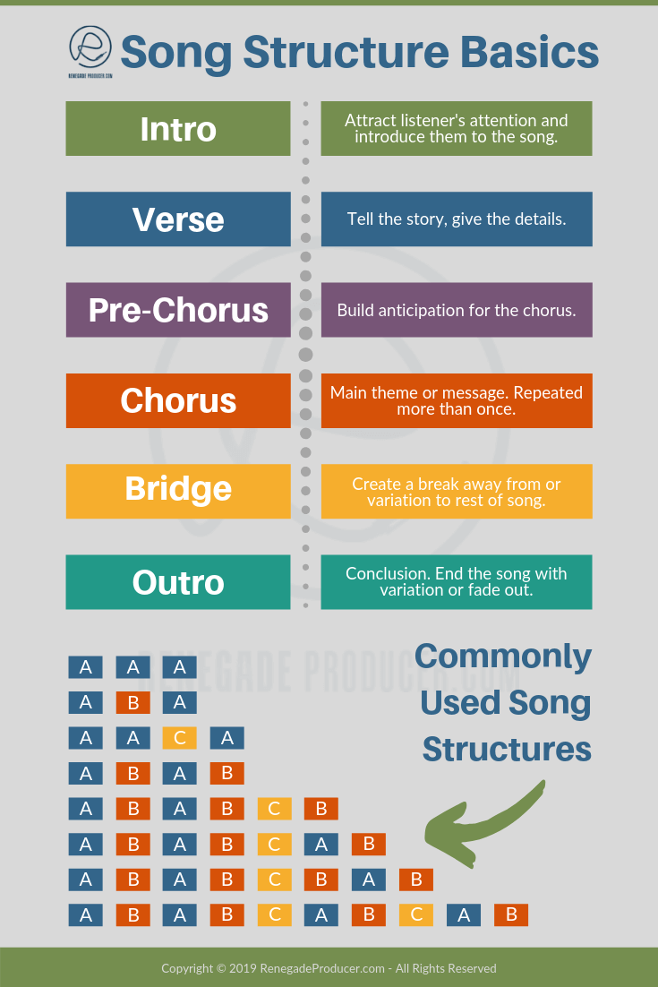
Song Structure

Slide 12
What is song structure?
A song structure refers to arrangement of a songs various parts which can change the songs emotion tempo and dynamics depending on the section of the song.
The most basic song structure would be intro, verse — chorus — verse — chorus —bridge — chorus — outro. But there more complicated and strange song structures for example chorus-verse-bridge-verse-verse-outro
Most individual parts of each song can vary with how many instruments are in the section or how dynamically loud or quiet the song.
The best example of this in a song is that the verse is usually the quietest section and the chorus is usually the loudest section
Song structure can also be described with any letter of the alphabet with a usually being the intro or verse b being the pre chorus or bridge c being he chorus etc.
In my song the song structure I will use will be abit of a strange one as it goes chorus-bridge-hook-solo-bridge-chorus 2-bridge-interlude-outro

Slide 13
Examples of song structures
Songs with a basic structure
Paranoid Android
Songs with a strange structure
Nowhere man
Songs with just one section
Tequila
Songs with just two sections
Yesterday (Remastered 2015)

Slide 14
Lyric writing

Slide 15
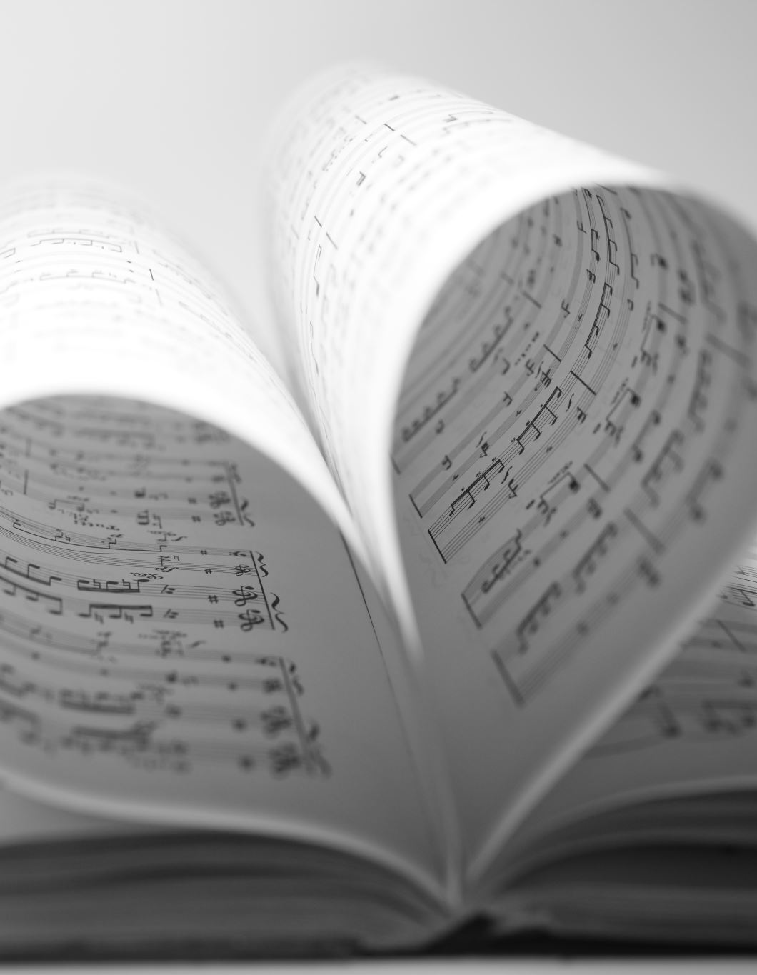
What is lyric writing?
Lyric writing is one of the other main pieces of a song and can help convey your emotion and get your point across in the song with blatancy or hidden meanings in the lyrics
Some songs don’t need lyrics but commonly in pop music songs do have lyrics and the lyrics can be written by you personally or someone else and the phrase that is commonly used in the industry is a "lyricist"
Most songs when written usually include the song name and this can be a commonly used in the song for example in the song hey jude the lyric "hey jude don’t make it bad take a sad song and make it better" then the song goes onto use it at the start if every verse
Lyrics can change the emotion of the song and you can do happy songs and sad lyrics and sad songs with happy lyrics this is commonly known as juxtaposition.
In my song I shall be trying all of these possible way to write lyrics and experimenting to see what works best

Slide 16
Examples of these lyric writing techniques
Juxtaposition:
https://www.youtube.com/watch?v=yzHXtxcIkg4
Hook lines
https://www.youtube.com/watch?v=92cwKCU8Z5c
Song with hidden meaning
https://www.youtube.com/watch?v=Wm54XyLwBAk

Slide 17
Time signature

Slide 18
What is a time signature?
Time signature is how many beats in a bar in that song
The most commonly used time signature is 4/4 but there are many other used signatures such as ¾ 6/8 7/8 and majority of them are used for certain genres such as 4/4 being mainly pop orientated and 6/8 and 7/8 being jazz orientated
In some cases you have rock or pop artist that change things up a little and use unusual time signatures such as the foo fighters "times like these" which would be in 7/4
This is very uncommon in the industry but can been seen in quite a few popular songs over the years
However in my song to not over complicate things I will be using 4/4

Slide 19
Examples of time signatures
4/4
https://www.youtube.com/watch?v=A_MjCqQoLLA
¾
https://www.youtube.com/watch?v=QwVjTlTdIDQ
6/8
https://www.youtube.com/watch?v=N4bFqW_eu2I
7/8
https://www.youtube.com/watch?v=fHiGbolFFGw
7/4
https://www.youtube.com/watch?v=rhzmNRtIp8k

Slide 20
How this will benefit my composition?
This research and information will benefit me and my composition by helping me better my song writing and incorporating these techniques to make my songs a professional standard
It will benefit me by making me better at convey my emotion through juxtaposition and subtle messages
I will also use this to better my structures in my songs and experiment with dynamical changes and new time signatures
I can also experiment with new types of melodies and using key signatures and more complex chords in my songs.

Slide 21
My composition

Slide 22
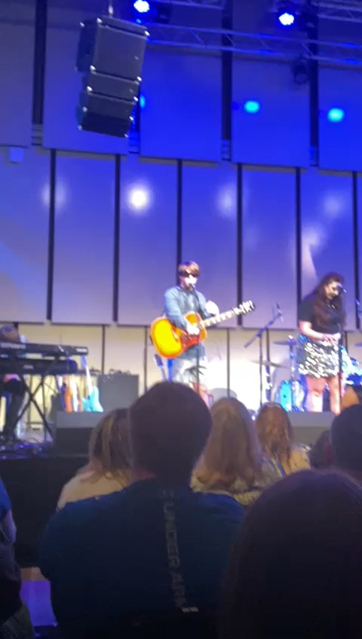
My Final Rendition Of My Composition

Slide 23
Thank you!

