Slide 1

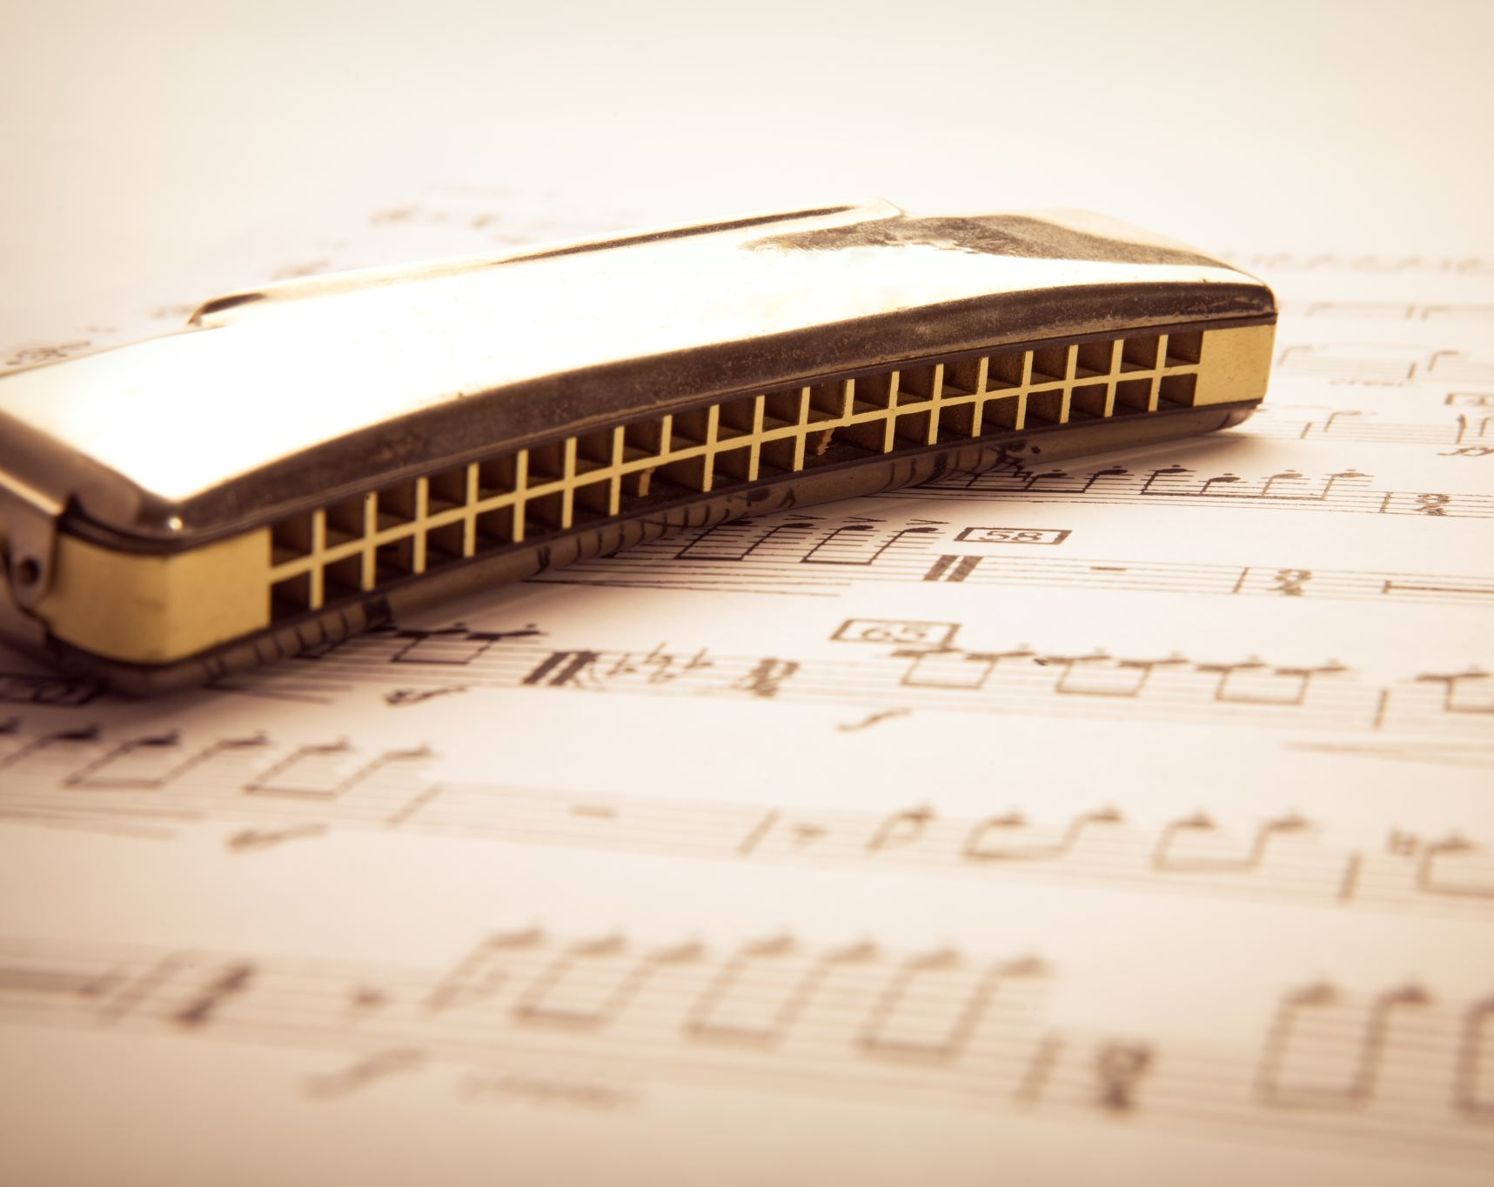

SONG ANALYSIS
By Ryan Smith
Notes:
Hi I’m Ryan and this is my presentation on song analysis for protest songs

Slide 2
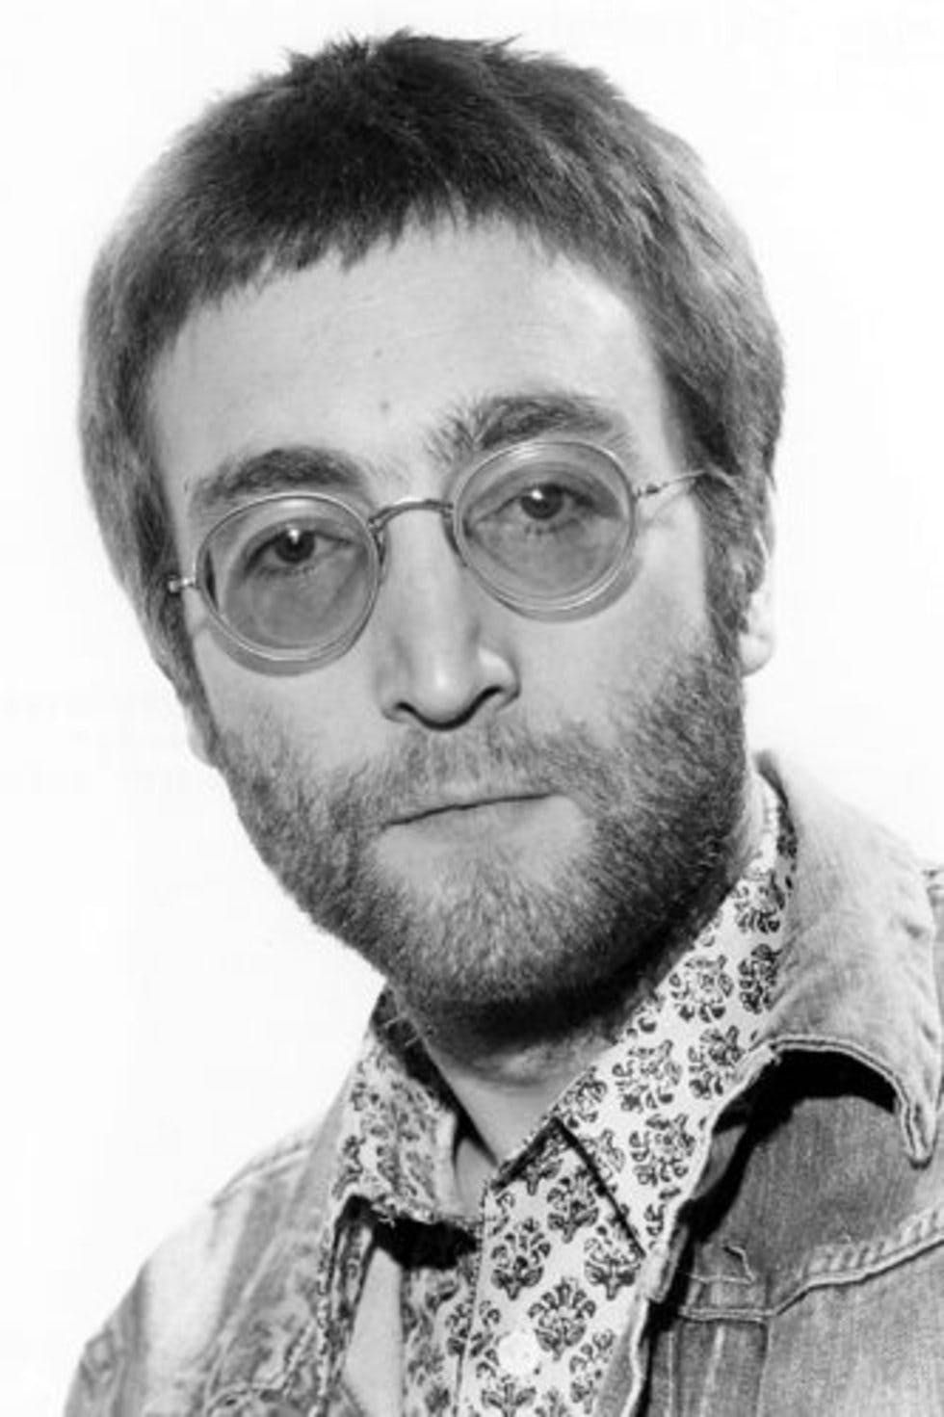
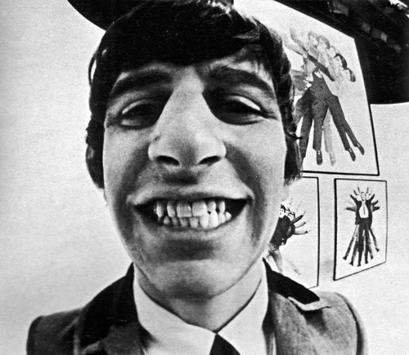
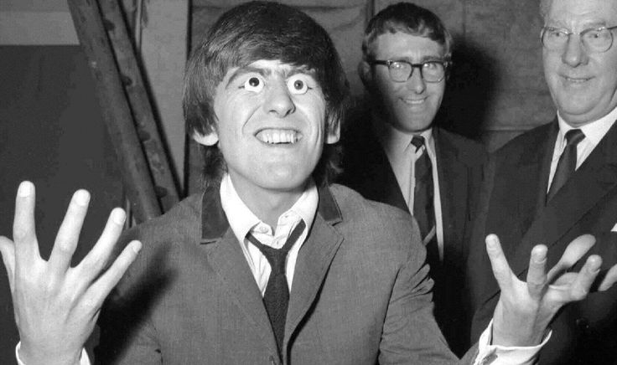
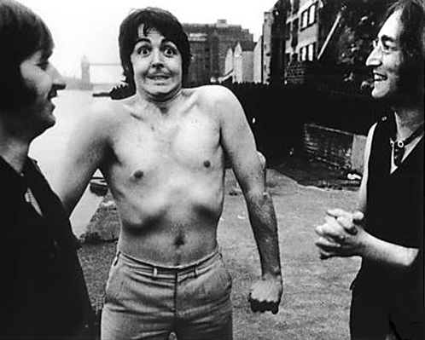
Revolution- The Beatles
Notes:
Our first song on the list is revolution by the Beatles

Slide 3
Instrumentation
Guitar
Drums
Bass
Electric piano
Notes:
In this song we have a classic rock band set up consisting of guitar bass drums keys and vocals

Slide 4
Instrumentation
The Guitar's in this track have a lot of overdriving distortion and have a punchier effect for a song of this era they achieved this by using the attack settings on the amplifier and the attack settings on a gain pedal.
The bass is punchy and a prominent sound in this track due to the Beatles wanting their busy basslines significantly more visible than other bands
The drums are simplistic only utilising a snare at times but are affective and cater to the song well as much isn’t needed for a classic rock n roll track.
The electric piano is not played by any of the Beatles and has a very bluesy feel to it when it is prominently heard in its solo
This song is a classic 12 bar blues but in triplet timing on the guitars as its very bluesy.
Notes:
In this we have overdriven guitars which is prominent in the late 60s a punchy bass line which the Beatles loved the use of an electric keyboard with a blues style solo drums that a very simple but affective in there own right and a very common raspy John Lennon vocal

Slide 5
Harmony&Tonality
The song is in a major key with a happier feel compare to most protests songs at the time most protest songs are sad and trying to raise awareness on the problem however John wrote it with up beat feel telling Everyone that they can stand up for what they thinks right if they want to and don’t let anybody stop you.
The song is also in the key of A
Notes:
This song is in the key of a major and is played at 121 beats per minute which gives the song a nice up beat feel unlike a lot of protest songs that are quite slow and moody

Slide 6
Structure
The songs structure is a standards structure at that being verse,pre chorus,chorus,verse,pre chorus,chorus,solo,verse,pre chorus,chorus and ending
Or in shorter terms A/B/C/A/B/C/D/A/B/C/E
Notes:
The structure of this song is A/B/C/A/B/C/D/A/B/C/E

Slide 7
Rhythm and time signature
The song is in 4/4 and uses a 12 bar blues which is suitable for music of the time
The song is played at 121 bpm or beats per minute meaning it’s quite fast paced and energetic
Notes:
The songs time signature is in a standard 4/4 and uses a 12 bar blues to its advantage as it was very commonly used in this era of music

Slide 8
Historical impact
The song was a big impact on the peace movement in the 60s as at the time there was an on going war between America and Vietnam and the Beatles had an impact as they was the biggest band in the world at that time and the most influential people at that time
Notes:
This song being brought out in the 60s meant that this would have had a huge affect on the peace movement among hippies around the world at this time

Slide 9
Melody (lyric meaning)
But when you talk about destruction
Don't you know that you can count me out
“You say you want a Revolution
Well, you know
We all wanna change the world”
this is saying we all want a revolution and something to change so we all need to stand up for what we want.
The songs feel is about bringing the Vietnam war to a close and bringing the world to peace.
This is also suggesting that if you thinking about war then I don’t want any part in it which is a perfect example of showing peace around the world
Notes:
To further back up my evidence I have analysed some of the more important lyrics in this song such as the first verse which tells me that Lennon is saying we all want peace and we can have it if we all stand up for what’s right

Slide 10
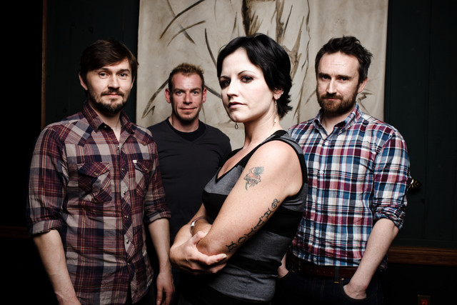
Zombie- The Cranberries
Notes:
The second we will look at today is zombie by the cranberries

Slide 11
Instrumentation
Guitar
Drums
Bass
Vocals
Notes:
The instruments in this song are another classic rock band set up with guitar bass drums and vocals

Slide 12
Instrumentation
The song uses two distorted guitars with warmer sounds which adds to the feel of the song
The drums aren’t a usually beat for a rock song and are quite unusual in a rock set up
The bass is quite simplistic and simple yet the bass is punchy and prominent in the song
Notes:
The song uses distorted guitars and punchy bass to help build intensity and to further increase the intensity we have a very unusual drum beats on a rock song

Slide 13
Harmony and tonality
Zombie is in the key of e minor which explains it’s quite dark a gloomy feel within the song and it’s feeling of intensity rises throughout
The song is quite dark and has to be due the context of the song being about two children is the rupublican army in the Warrington bombings in 1993
Notes:
Zombie is in the key of e minor which explains the dark and gloomy feel within the song and the building tension about the significant event they are talking about in history

Slide 14
Structure
The songs structure is verse/pre chorus/chorus/post chorus/verse/pre chorus/chorus or in shorter terms A/B/C/D/A/B/C
Notes:
The songs structure is quite a standard structure being A/B/C/D/A/B/C

Slide 15
Rhythm and time signature
Zombie is in a standard 4/4 time signature and is played 167 bpm
This suggest that the song is quite fast pace and helps us understand why the song can feel so intense to listen to
Notes:
Zombies time signature is in a standard 4/4 and is played at 167 beats per minute which further adds to the intense feeling of the song

Slide 16
Historical impact
This song is about the Warrington bombings and two young kids who where in the bombings when all the chaos in Ireland was happening to so at the time for the cranberries to write this song they must have thought the world was falling apart.
Notes:
This song is about the Warrington bombings of 1993 where tow young kids where killed by the bombings and this has significant impact on them also due to all the chaos going on in Ireland at the time to

Slide 17
Melody
With their tanks, and their bombs,
and their bombs, and their guns
It’s the same old theme, since 1916
In your head, in your head, they’re still fightin’
This suggest to me that the cranberries don’t understand the point in the violence around the world and why people would want to commit such acts of pointless violence
The Easter Rising was an armed insurrection in Ireland during Easter week, April 1916. The Rising was launched by Irish Republicans to end British rule in Ireland and establish an independent Irish Republic while the United Kingdom was heavily engaged in World War I. This is the cranberries basically telling us that nothing changes and we are still in the same old mindset as we used to be
Notes:
The lyrics in this song further add to our rising tension for example in the use of the lyrics with their tanks and their bombs and their bombs and their guns suggest that they don’t understand why all of this violence is needed

Slide 18
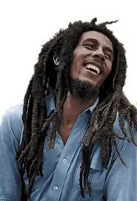
Get up stand up- Bob Marley
Notes:
My 3rd song is get up stand up

Slide 19
Instrumentation
Vocals
Guitar
Bass
Drums
Keys
Percussion
Congas
Bongos
Notes:
In this song we have quite the Caribbean influence with the use of congas and bongos within this song

Slide 20
Instrumentation
The instruments in the song have a reggae sound to them due to the song being made by Bob Marley being a reggae artist
The song includes many Caribbean influence style instruments such as congas and bongos
The guitars have a ska influence with a syncopated back beat
The drums also have a ska influence into a now turned reggae beat
The bass is ver prominent and punchy and has a walking bassline going on
And the keys are also syncopated in the song
Notes:
This song is ska/reggae with a syncopated off beat within most of the instruments such as guitar and piano and also a ska shuffle on the drums

Slide 21
Harmony and tonality
Get up stand up is in a minor key and is in the key of c minor which explains the very bogged down feel to the song which is a reoccurring theme within protest songs due to them being more to be heard for there intense nature than to be popular
Notes:
This song is in the key of c minor which explains the very bogged down feel of the song which shares many commonalities with other Bob Dylan’s songs

Slide 22
Structure
The song structure is standard with there being an intro/verse 1/chorus/verse 2/bridge/verse 3/outro
In shorter terms A/B/C/B/D/B/E
Notes:
The structure within this song is abcbdbe

Slide 23
Rhythm and time signature
The song is in 4/4 and has a Bpm of 78 meaning the song is quite slow which is quite common in a lot of Bob Marley songs
Notes:
The song is also in 4/4 and is our slowest song of the presentation being played at 78 beats per minute which adds further to the moody feel of the song

Slide 24
Historical impact
This song was influenced by Bob’s trip to Haiti and his first hand experience on poverty of the islands people so he wrote a song to protest against poverty and how we should make a change for those of the poorest nature
Notes:
This song is influenced by bobs trip to Haiti and how he witnessed poverty face to face with the island people

Slide 25
Melody
Preacher man don't tell me heaven is under the earth
I know you don't know what life is really worth
It's not all that glitter is gold and
Half the story has never been told
So now you see the light, aay
Stand up for your right. Come on
Get up, stand up, stand up for your right
Get up, stand up, stand up for your right
Get up, stand up, stand up for your right
Get up, stand up, don’t give up the fight
Don’t let others oppress you. Stand up for your rights as a human being. Similar to a famous quote by Emiliano Zapata “I’d rather die on my feet than live on my knees”
This tells me that Bob is saying it’s not all about having gold and being filthy rich but just having the privileges we all deserve can make the difference such as a clean living space or food and water
Notes:
The lyrics suggest to me that Bob isn’t saying they need gold or bug riches but people deserve the basic rights in life such as a clean home and food and water because that’s every humans right to live

Slide 26
Thank you!
Notes:
Thank you for listening to my presentation

