Slide 1

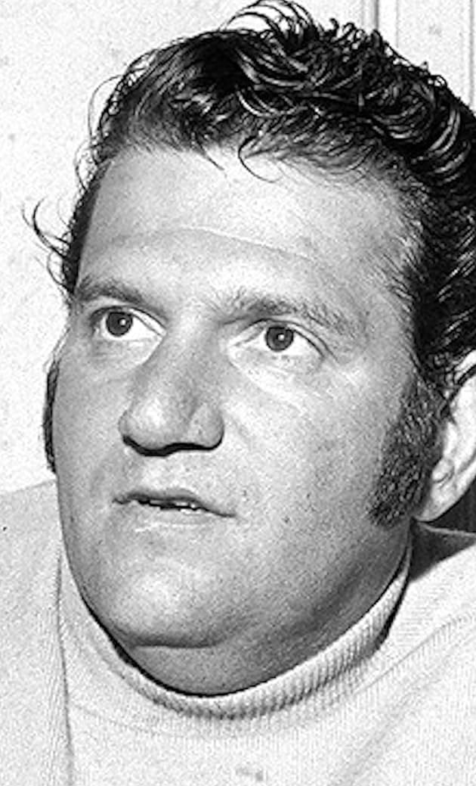
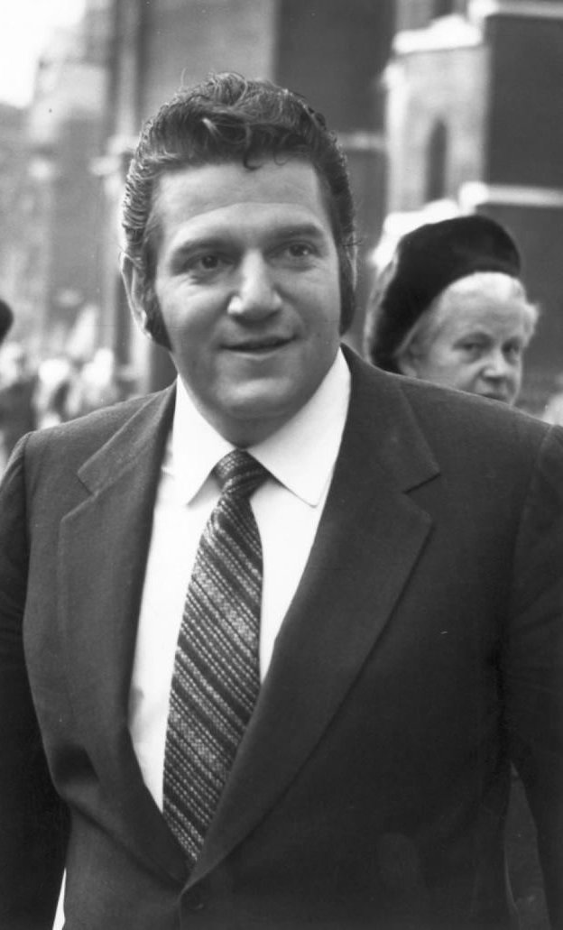
Case Study 1:Allen Klein

Slide 2
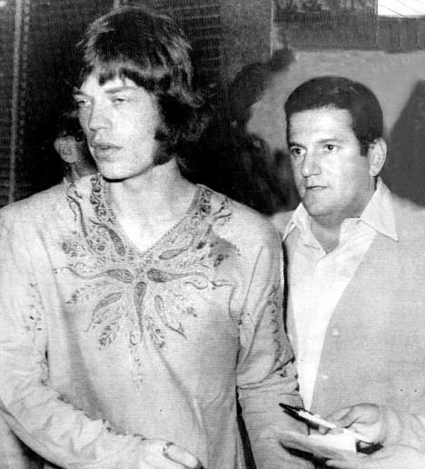
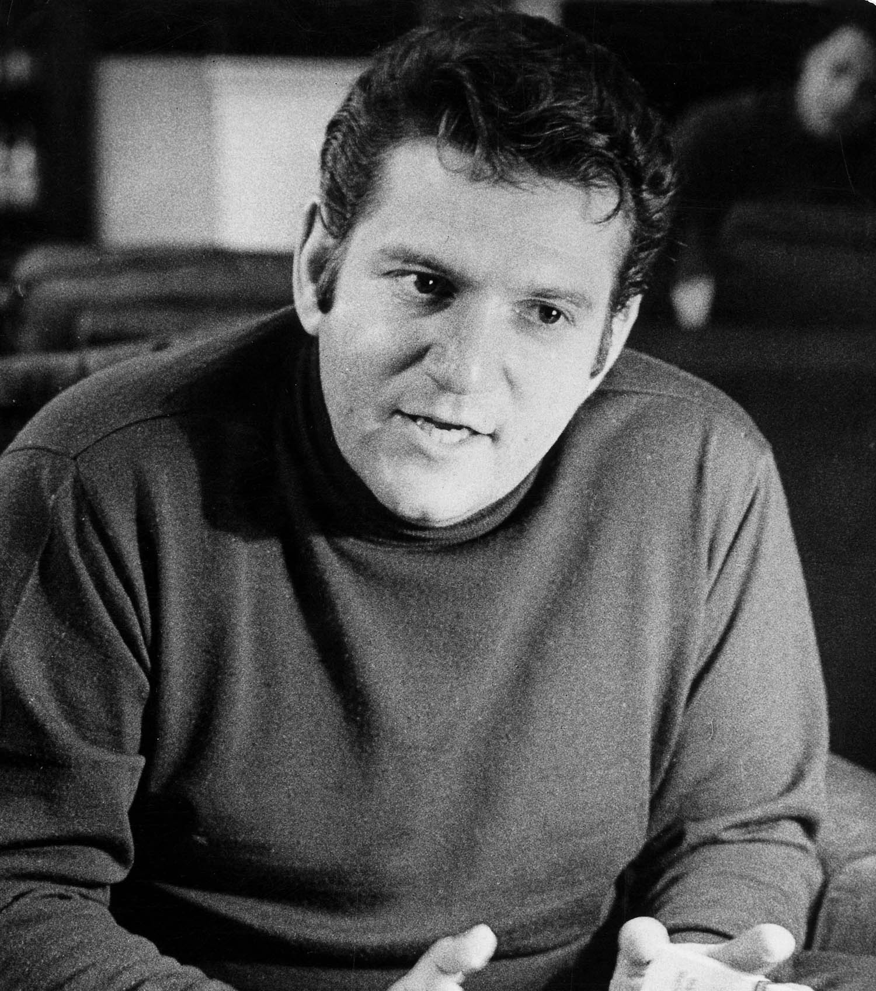
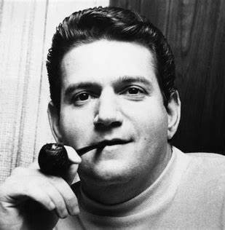
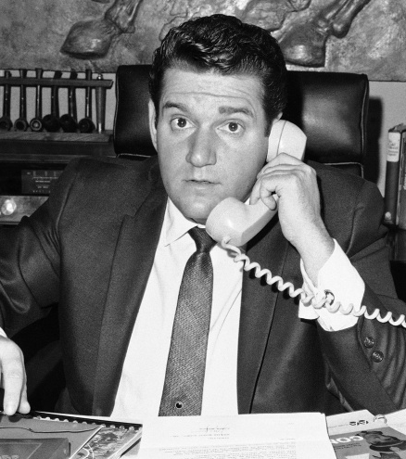
INTRODUCTION
Notes:
Allen Klein is one of the biggest most controversial managers in music history from managing the rolling stones and the Beatles to being sued for money laundering.
He was also back in the day the man everyone wanted to be managed by in the 60s and 70s.

Slide 3
Allen Kleins role
Negotiating
Handling media/public relations
Financer
Discography management
Album and single releases
Notes:
Allen Kleins role is to make sure that the bands day to day life is easier by looking after things that are personal for them such as negotiating new record deals and contracts, handling the media and public relations and maintaining there good image in the public eye as he was managing the two biggest bands in the world at the time. He controlled there finances and what money was spent on invested into or what royalties where given to them. He also managed there discography and when albums and singles would be released he also approved of art work for albums and what albums would go out.

Slide 4
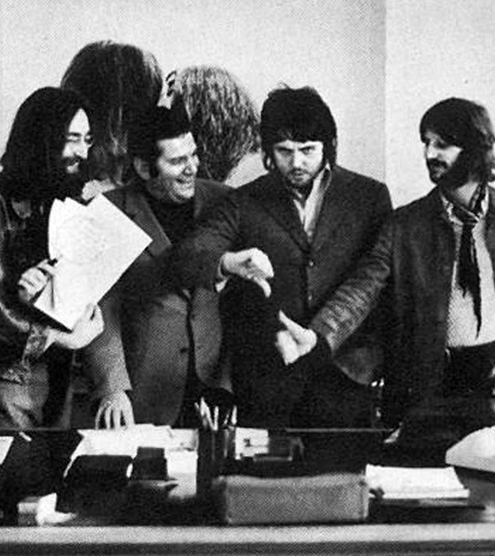
The importance of a manager
Notes:
A MANAGER IS IMPORTANT IN ANY JOB ROLE AND ESPECIALLY IN MUISC AS THE MANAGER KEEPS THE BAND IN SHAPE IN THERE PERSONAL LIVES AND IN THE MEDIA BY KEEP THEM OUT OF TROUBLE AND REPUTABLE IN THE PUBLIC EYE THEY ALSO MAKE SURE YOU ARE WELL PREPARED FOR GIGS AND FINANCIALLY SECURE

Slide 5
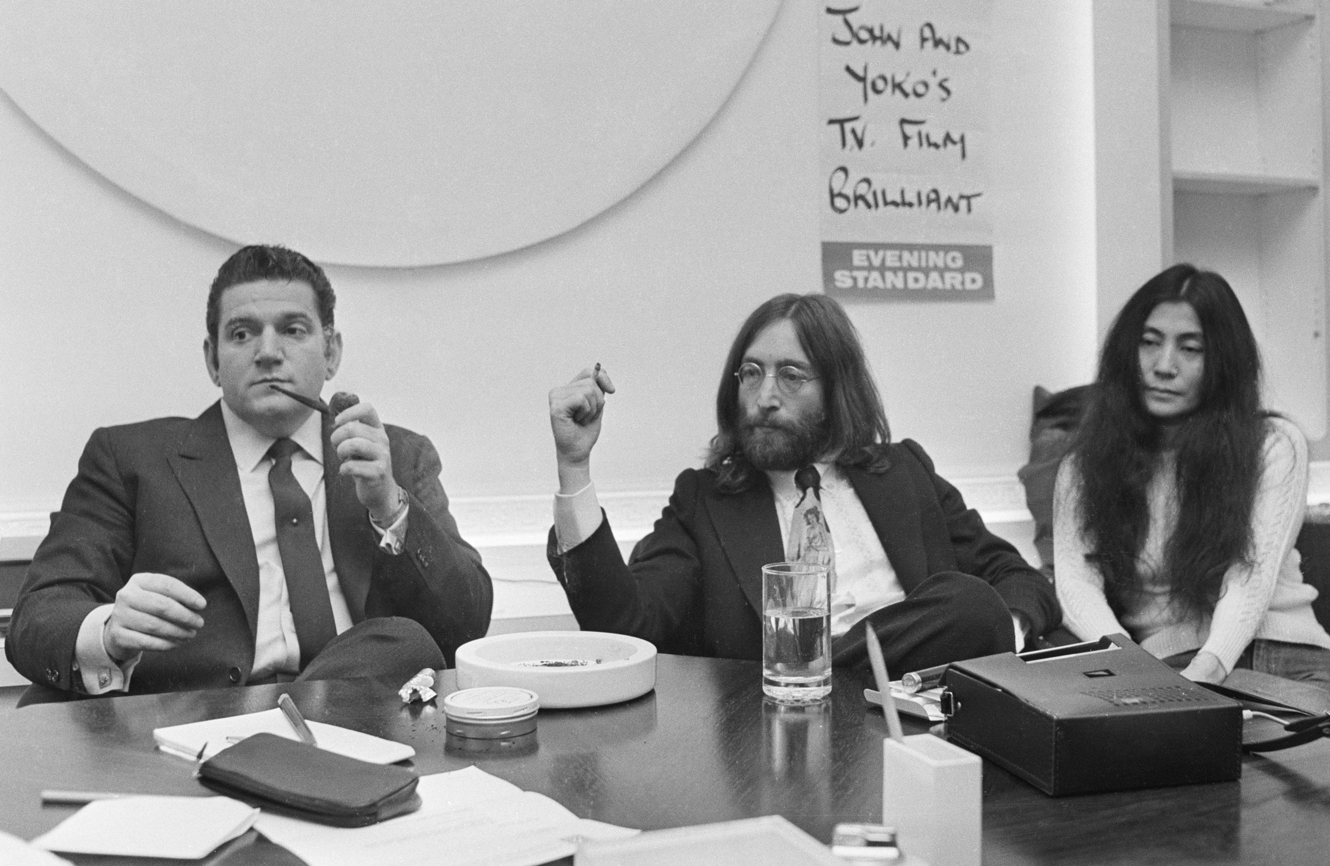
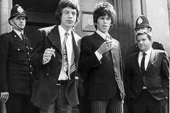
Klien’s Reputation
Case study 1 Paul McCartney:"I had to fight them for my bit of The Beatles, and in fact, for their bit of The Beatles”
https://www.musicradar.com/news/mccartney-lennon-allen-klein-beatles
Notes:
As Klein was notoriously know for managing the two biggest bands it meant he must have been a great manager? The real answer is no. Klein was a business man and in the 60s going through to the 70s didn’t really care for the bands financial security but more of how much money he can make out of the bands royalties he was a financial genius. His plan for both bands was make them happy by getting them better deals so they got more money and agree to be come there financial adviser and eventually renegotiate his contracts and take a lot of there money for himself. In shorter terms Klein was a conman and was being financially greedy towards the beatles and the rolling stones.

Slide 6

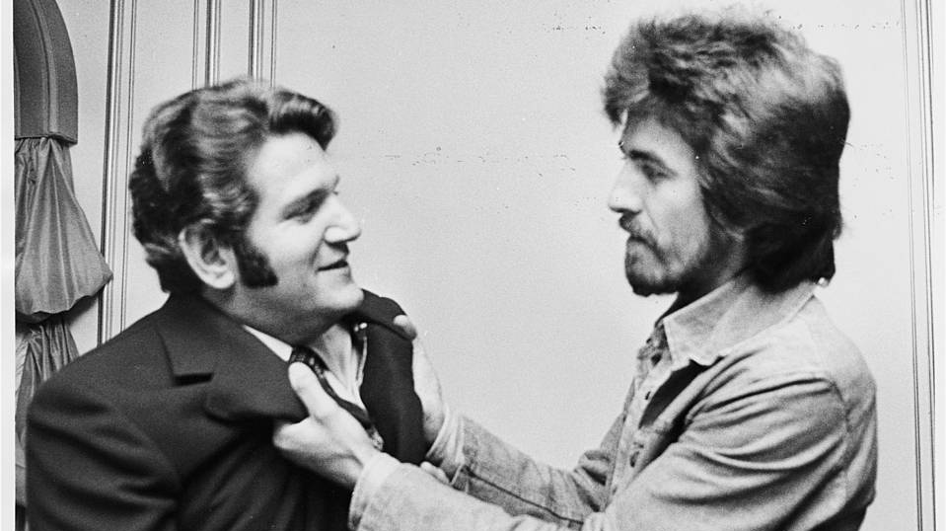



How I am going to be better than this
Notes:
Im going to be better at this by providing clarity to the band about financial problems and being a trustworthy person

Slide 7
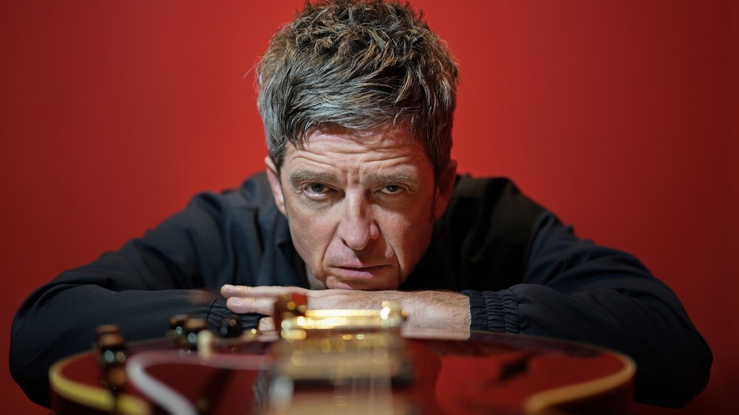
Case study 2:Noel Gallagher

Slide 8
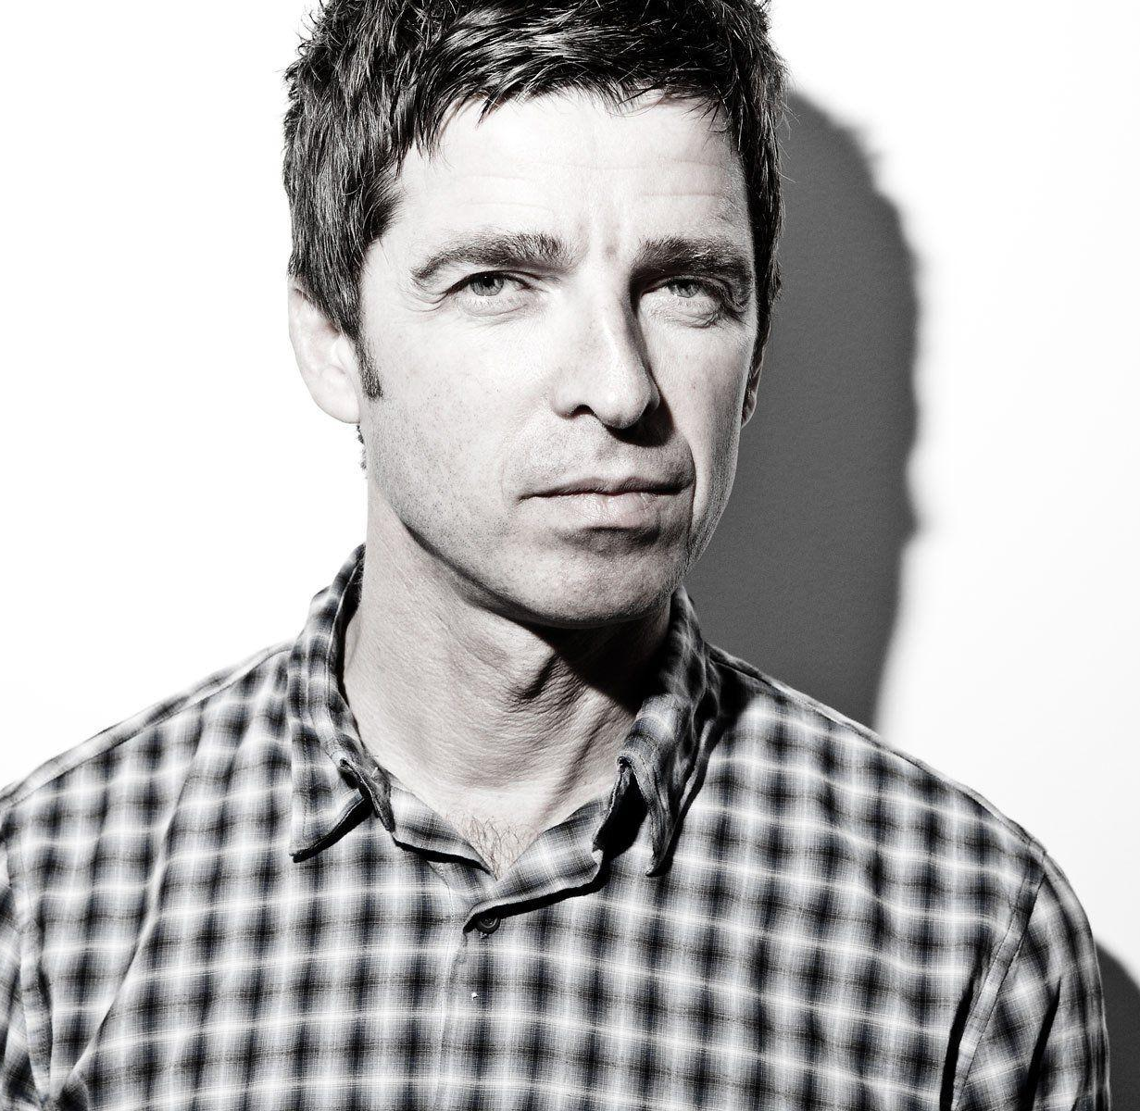
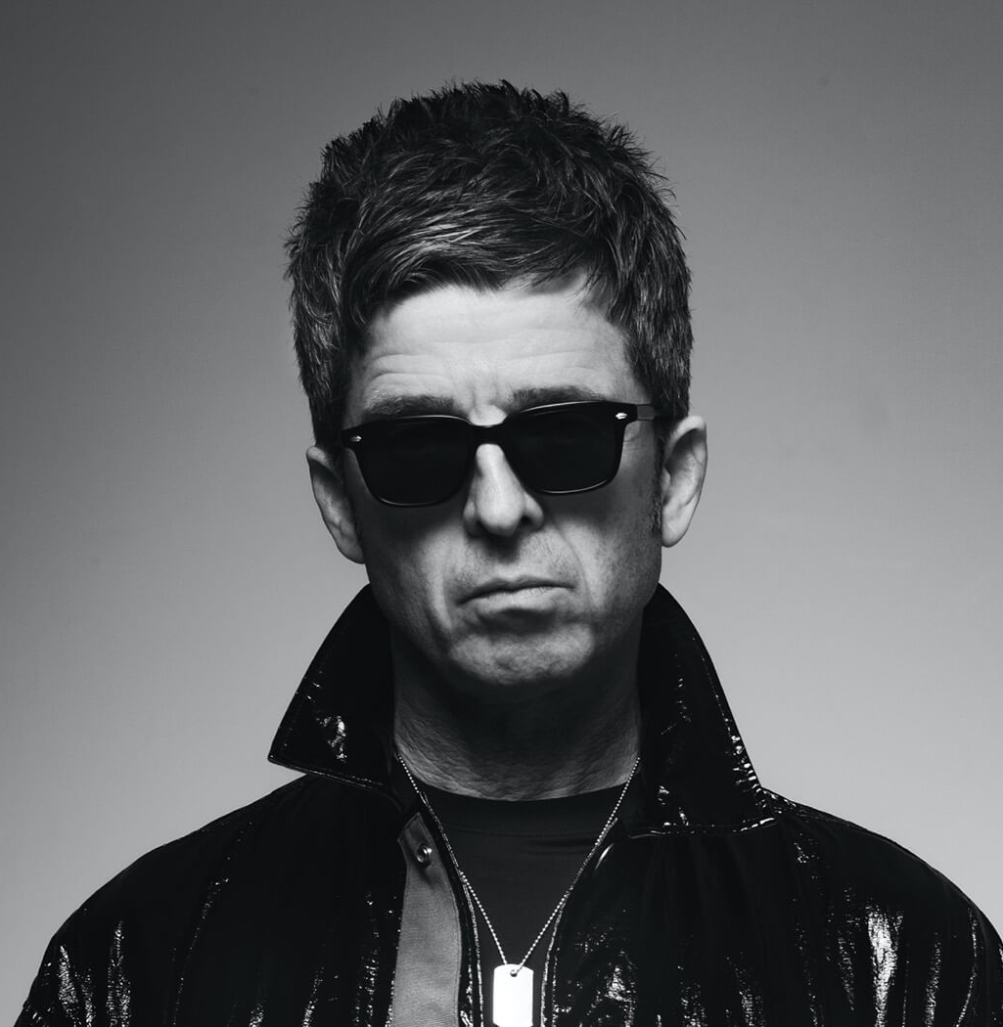
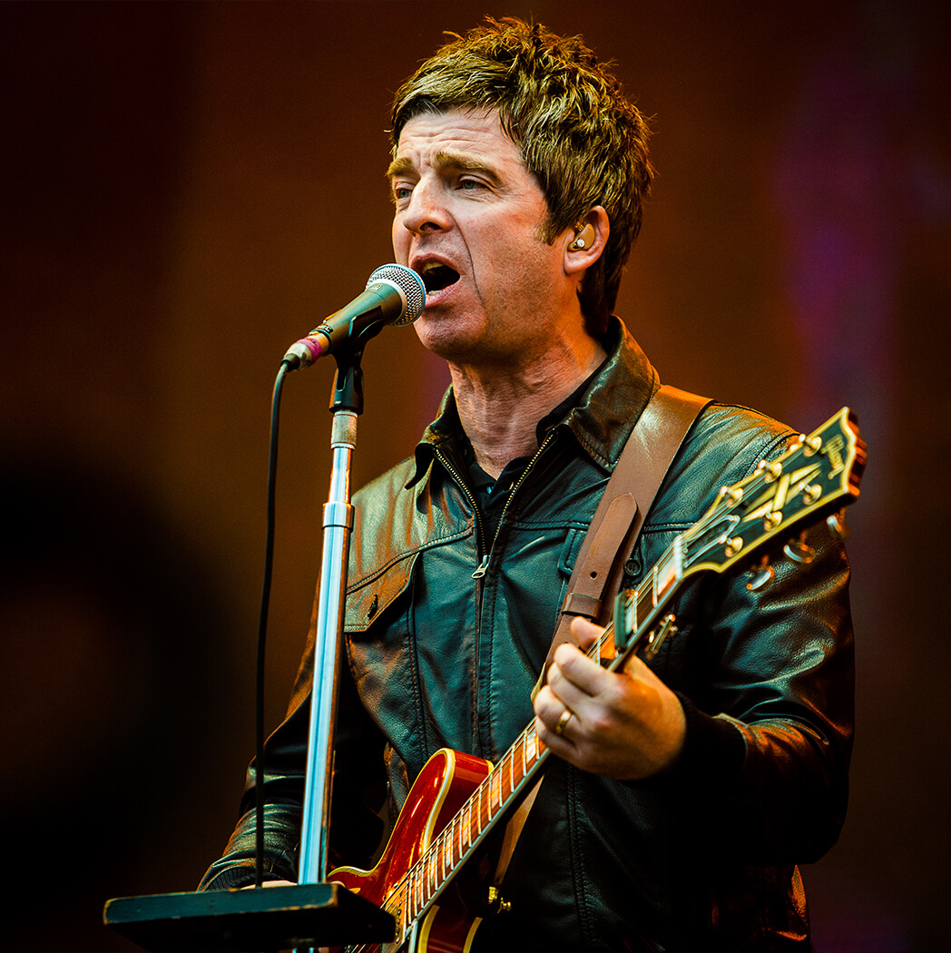
Introduction:
6 brit awards
2 ivor novello’s
5 MTV awards
17 NME’S
9 Q award’s
1 totp award
Notes:
Noel Gallagher is the lead singer songwriter and guitarist of bands such as Oasis and noel Gallaghers high flying birds

Slide 9
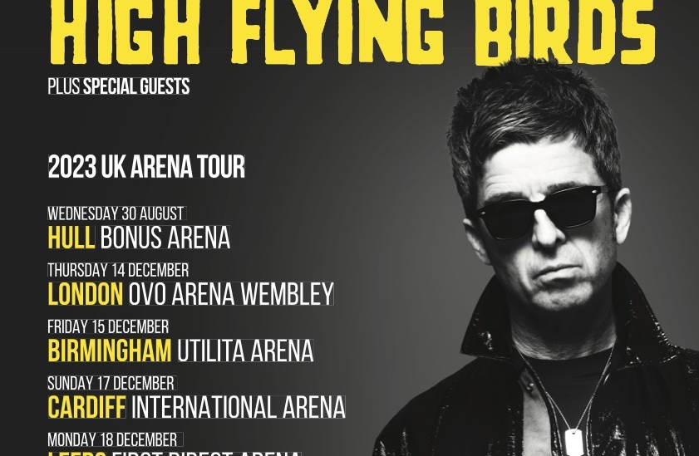
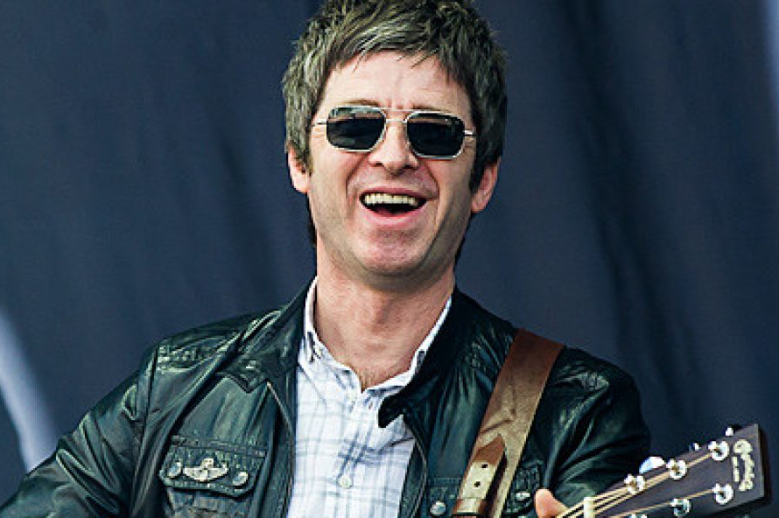
How Noel feels about touring.
“Sometimes you do get a bit jaded about what you do,” Gallagher told the audience. “Sometimes you kind of treat it as a job, but on this tour it’s been fucking great. It’s like, ‘I am amazing, fucking hell’.” https://www.nme.com/news/music/noel-gallagher-compares-touring-solo-to-life-on-the-road-with-oasis-and-how-many-of-his-fans-wear-pretty-green-2393109
Notes:
From what I have research noel these days take touring a bit more serious than the oasis days but noel seems to generally love his job and playing his music to his fan around the nation as he has many big hits with the high flying birds and oasis which are anthems within the country and other countries this is important to me as it teaches me to enjoy touring no matter the circumstances

Slide 10
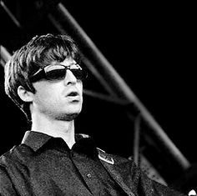
Does Noel stay healthy on tour?
In the early days of touring in the mid 90s Noel his brother Liam and Oasis where very hard hitting with drugs by abusing substances cannabis stimulants and alcohol. However, Noel realised this was taking a tole on his body in the year 2000 when his daughter was born and quit substances all together.
Nowadays Noel lives a clean life drug free and continues to tour with the same fun from the experience
Notes:
This is useful to me as it teaches me to not abuse substances of any kind as it can harm your body permanently and could ruin your performance with vocals or your instrument of choice at your gigs.

Slide 11
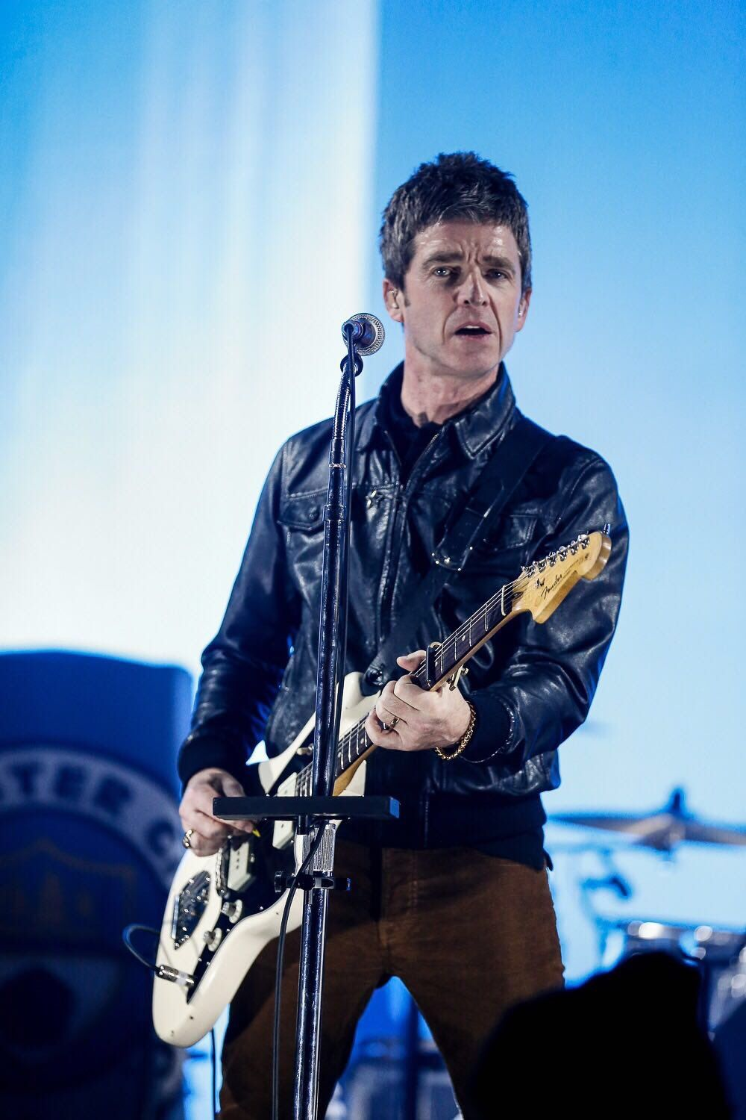
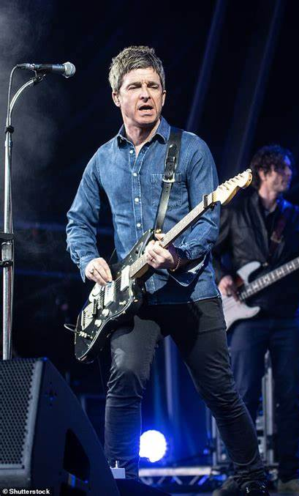
A video on noels opinions on drugs
https://www.nme.com/news/music/noel-gallagher-says-cocaine-gave-him-brutal-panic-attacks-and-left-him-hospitalised-2667515
“I had a few brutal panic attacks, which is why I quit.”
Notes:
This video explains how noel was deeply effected by drugs such as cocaine and lsd

Slide 12
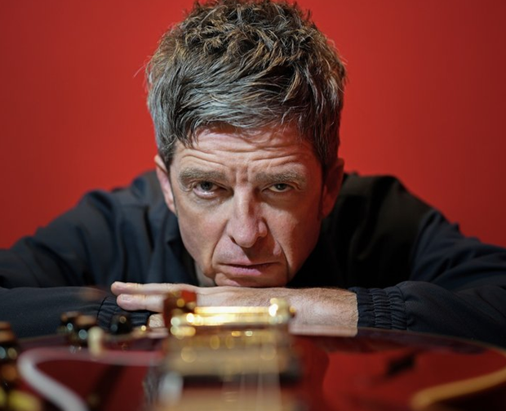
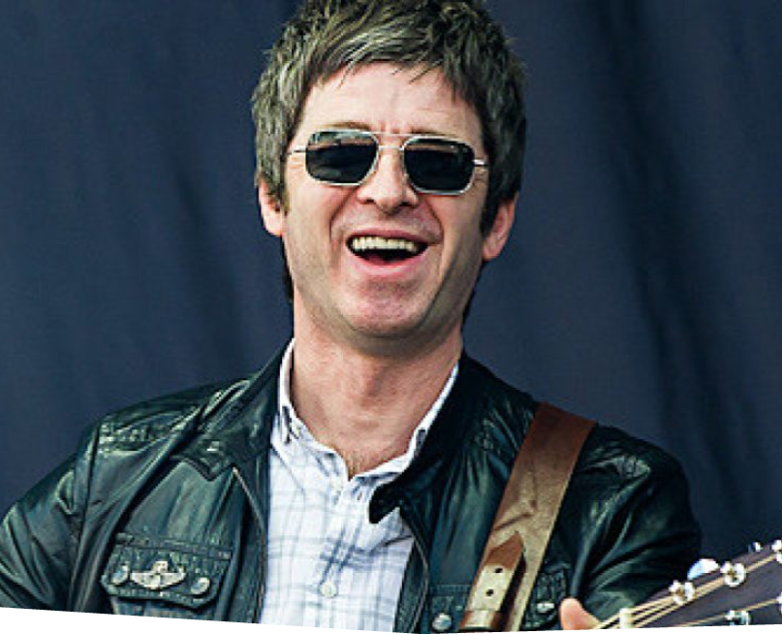
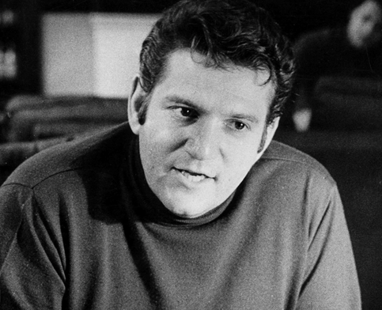
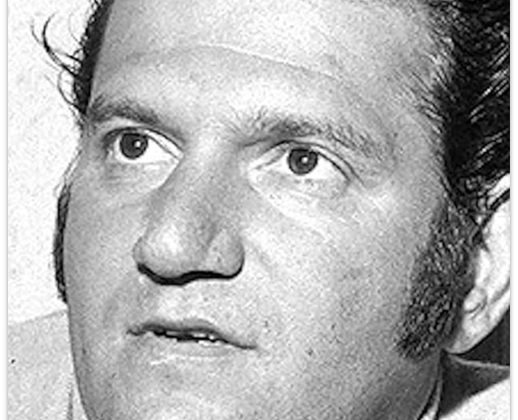
The End.
Notes:
Thank you for your time

